Slide 1


Main.Cpp
SPAM DETECTOR MODEL
PRESENTED BY: PHONG NGUYEN, CHAEWON PARK,
NICHELLE ANTONY, ESTHER KIM, TRISTAN RODRIGUEZ
main.cppdeanza@gmail.com

Slide 2
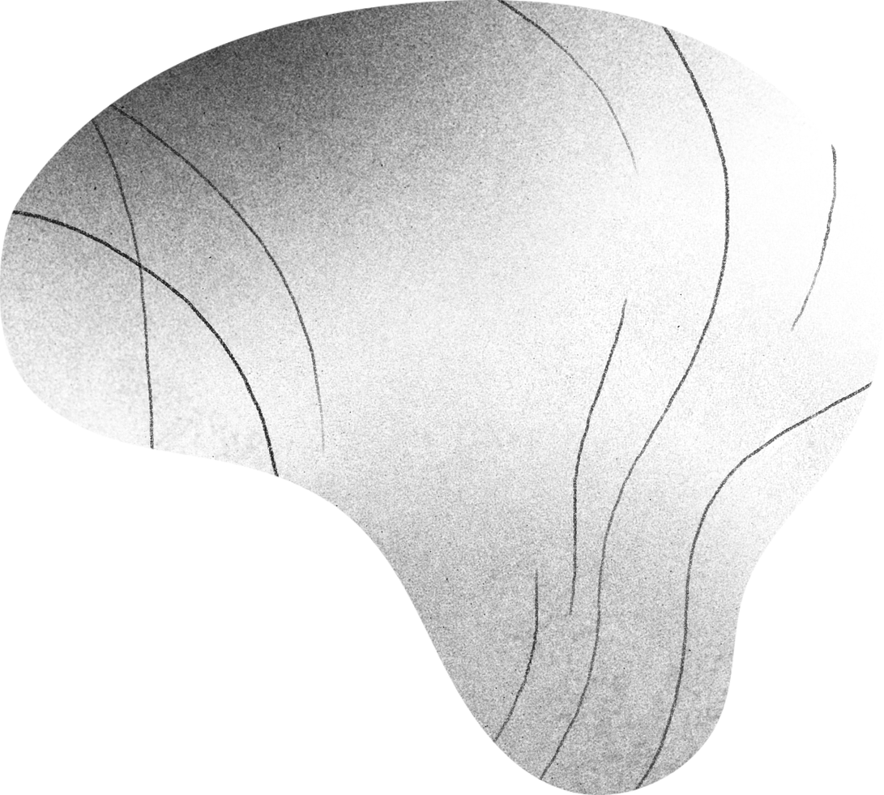
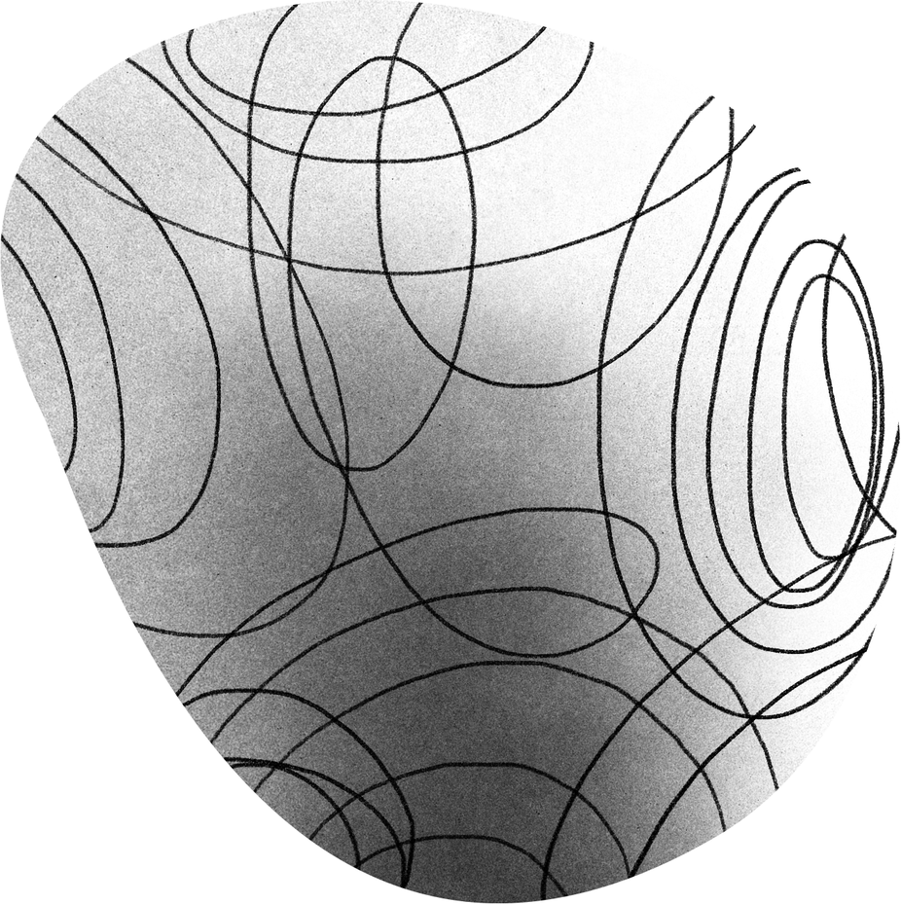
SPAM & HAM: What are they?
CONGRATULATION Main.Cpp member! You just won a 1000$ reward! REPLY NOW before your offer EXPIRES!

Slide 3
SPAM & HAM: What are they?
CONGRATULATION Main.Cpp member! You just won a 1000$ reward! REPLY NOW before your offer EXPIRES!
SCAM!!! But why? WHICH WORDS THROW YOU OFF???

Slide 4
SPAM & HAM: What are they?
CONGRATULATION Main.Cpp member! You just won a 1000$ reward! REPLY NOW before your offer EXPIRES!
SCAM!!! But why? WHICH WORDS THROW YOU OFF???

Slide 5
RULE-BASED APPROACH
Simple but is it effective?

Slide 6
Rule-based Approach
CONGRATULATIONS on WINNING, daughter!!! I’m so proud of you. Imma bank you 1000$ IMMEDIATELY for dinner!!!

Slide 7
Rule-based Approach
CONGRATULATIONS on WINNING, daughter!!! I’m so proud of you. Imma bank you 1000$ IMMEDIATELY for dinner!!!
AW, such a supportive dad!! BUT DOES THE MACHINE KNOW?

Slide 8
Rule-based Approach
CONGRATULATIONS on WINNING, daughter!!! I’m so proud of you. Imma bank you 1000$ IMMEDIATELY for dinner!!!
MACHINE: SCAM!!! (*Blocks dad immediately lol…)
Daughter: Doesn’t get her 1000$ :’<<

Slide 9
Rule-based Approach Limitation
  Harmless message can contain “suspicious” words.
  Scammers can bypass by avoiding those keywords.
  Can’t update the number of words forever!

Slide 10
Rule-based Approach Limitation
  Harmless message can contain “suspicious” words.
  Scammers can bypass by avoiding those keywords.
  Can’t update the number of words forever!
⟶ WE NEED A BETTER APPROACH!!!

Slide 11
SPAM ASSASSIN
CAN WE GRADE MESSAGES???

Slide 12
SPAM ASSASSIN: SScore Important Words
CONGRATULATION: 2.0
Winning: 1.0
[Money]: 1.5
Right now: 1.25
Lol / Ayo / Helu / Bye: -1.5
Dinner / Lunch: -2.0
Babe / Daughter / Son: -2.5

Slide 13
SPAM ASSASSIN: Score Important Words
CONGRATULATION: 2.0
Winning: 1.0
Lol / Ayo / Helu / Bye: -1.5
Dinner / Lunch: -2.0
CALCULATING the score IS AN ART
(COMBINE complicated algorithms & techniques )

Slide 14
SPAM ASSASSIN: Score < 5 is good
CONGRATULATIONS(2.5) on WINNING(1.0), daughter(-2.5)!!! I’m so proud of you. Imma bank you 1000$(1.0) IMMEDIATELY(0.5) for dinner(-2.0)!!!
MACHINE: 2.5 + 1.0 …. - 2.0 = 0.5 → 0. 5 < 5 → NOT SCAM
(Daugher gets1000$ from Dad for dinner: YAYYYYY)

Slide 15
TF - IDF
WHAT IF WE COULD TURN TEXT TO NUMBERS?

Slide 16
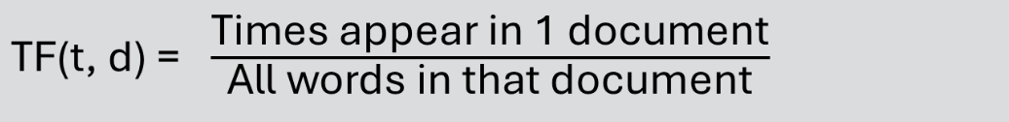
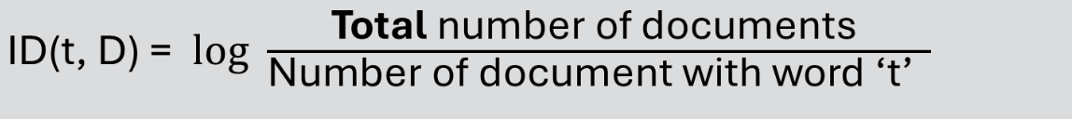
TF-IDF: Term Freq. - Inverse Document Freq.
TF-IDF(t, d, D) = TF X IDF

Slide 17
TF-IDF: Term Freq. - Inverse Document Freq.
Document 1: “Claim the FREE prize now!”
Document 2: “You just won a FREE holiday to Hawaii”
Document 3: “Reply to this message to receive an Iphone 18 Pro max”

Slide 18
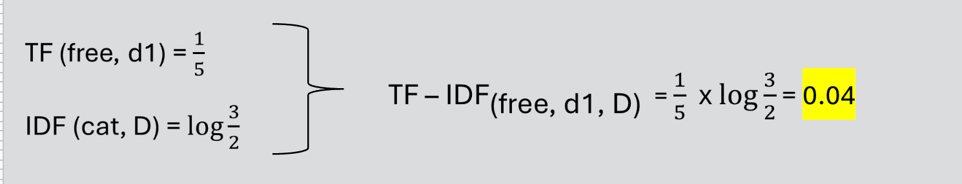
TF-IDF: Term Freq. - Inverse Document Freq.
Document 1: “Claim the FREE prize now!” (5 words)
Document 2: “You just won a FREE holiday to Hawaii”
Document 3: “Reply to this message to receive an Iphone 18 Pro max”

Slide 19
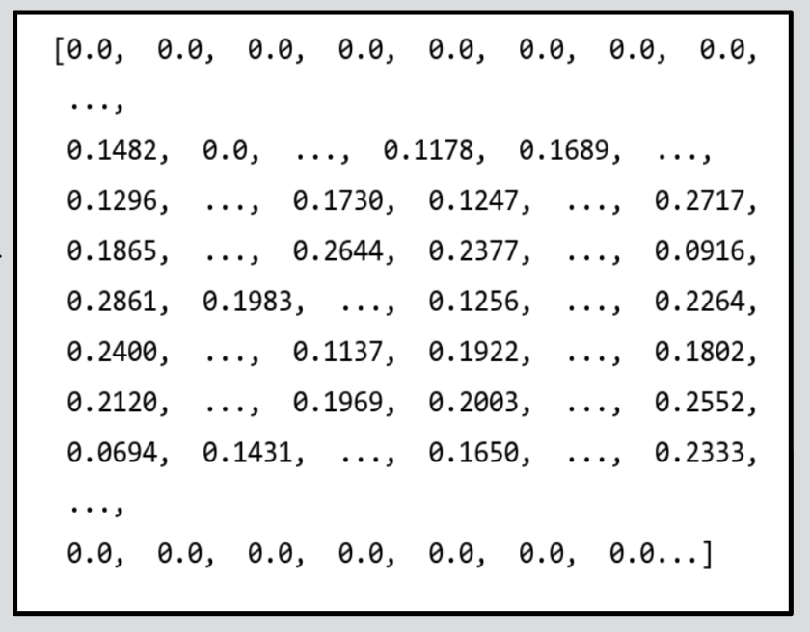
TF-IDF: Turn texts into numbers
Congratulations Main.Cpp member! You’ve been selected for an exclusive coding reward! Claim your free $100 tech gift card today before your offer expires! Click here now to secure your free prize

Slide 20


MACHINE LEARNING
ALGORITHMS THAT “LEARN” PATTERNS FROM DATA

Slide 21
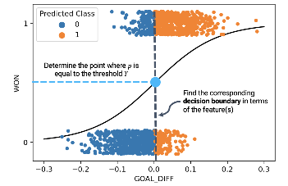
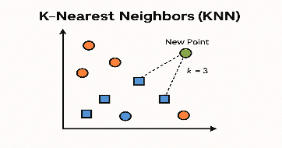
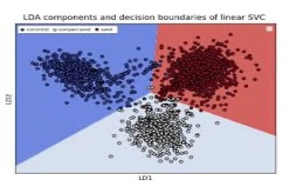
How Machine Learning is used
  TF – IDF converts text to numbers.
  Huge amount of data numbers shows patterns.
  ML Algorithms ANALYZE & LEARN patterns of HAM & SPAM
*Illustrative images

Slide 22
SAMPLE ML MODEL
EVERYTHING TOGETHER!!! HEHEHE

Slide 23
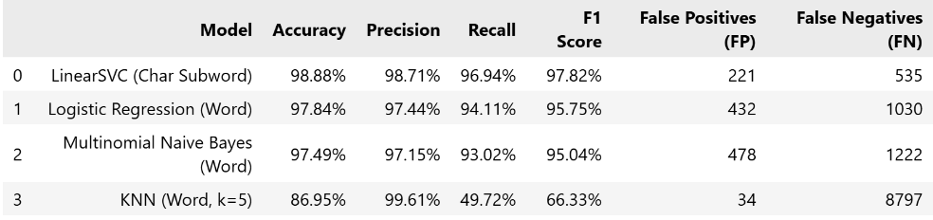
SAMPLE’S DATASETS
  UCI SMS Spam Collection
  Mendeley SMS Phishing
  Smishtank Phishing Corpus
  IMC 2025 ACM Smishing
  NUS SMS Corpus
EVALUATION

Slide 24
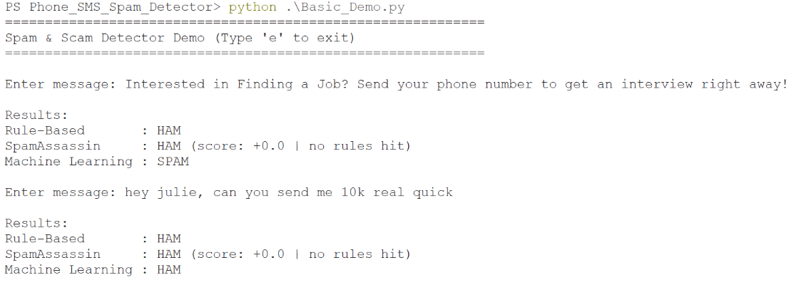
SAMPLE’S DEMO

Slide 25
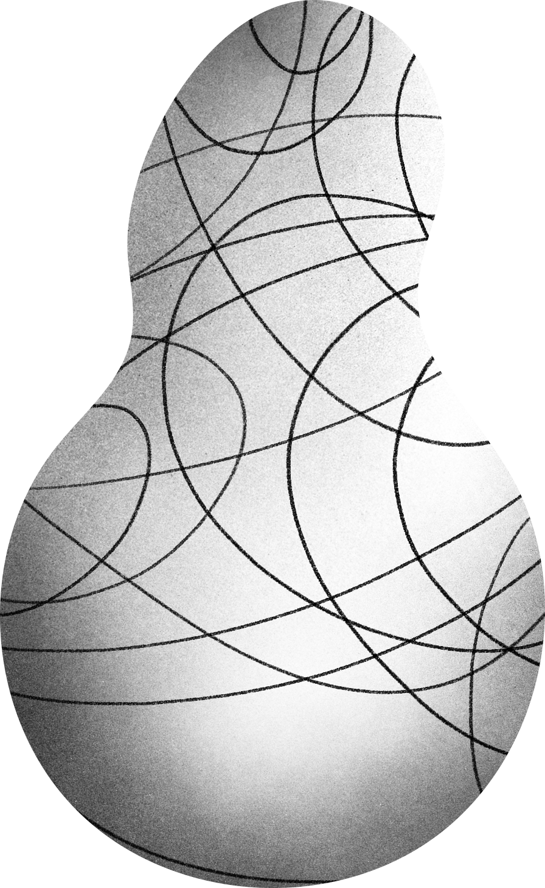

THANK YOU!
Main.Cpp
main.cppdeanza@gmail.com

